Slide 1
TOP 10
UNANSWERED QUESTIONS IN CONCUSSION RESEARCH

Slide 2
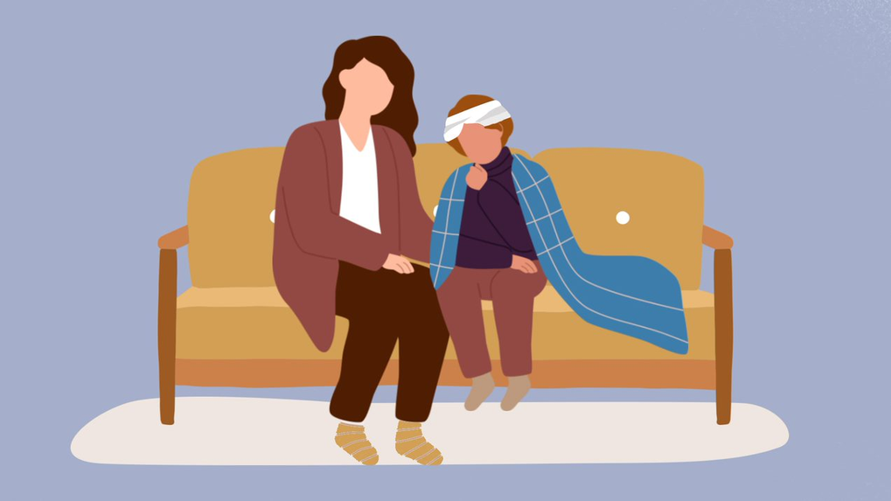
PREDICTION OF RECOVERY
What factors or tests best predict a prolonged recovery from concussion (known as post-concussion syndrome), and how can this information be used to develop a tailored strategy to manage the symptoms and support recovery?

Slide 3
RETURN TO COGNITIVE ACTIVITIES
After a concussion, what is the best timing and approach to return to cognitive activities in educational settings (e.g., school or university) and work settings to give the best outcome?

Slide 4
EARLY REFERRAL
What is the effectiveness of early referral and treatment by a concussion specialist team (e.g., with combined medical assessment, physical therapies, mental health support and other rehabilitation services) on concussion outcomes and length of recovery?

Slide 5
RETURN TO PHYSICAL ACTIVITIES
After a concussion, what is the best approach for a return to physical activity, exercise, and sports (i.e., timing, type, and intensity of activity) to give the best outcome?

Slide 6
HEADACHES
What is the most effective way to manage headache associated with concussion, and should people with a prior diagnosis of migraine be treated differently to get the best outcomes?

Slide 7
DIFFERENTIATING SYMPTOMS
What is the most effective way of differentiating prolonged concussion symptoms (known as post-concussion syndrome) from symptoms that are similar but unrelated to the concussion?

Slide 8
CHANGES IN THE BRAIN
What structural and /or functional (e.g. molecular, biochemical) changes occur in the brain with a concussion? How does the intensity and direction of forces involved in the head trauma cause the brain injury, and does location of the brain injury impact symptoms and severity?

Slide 9
LONG-TERM EFFECTS
What are the long-term effects of single or multiple concussions, and how do these effects impact day-to-day life?

Slide 10
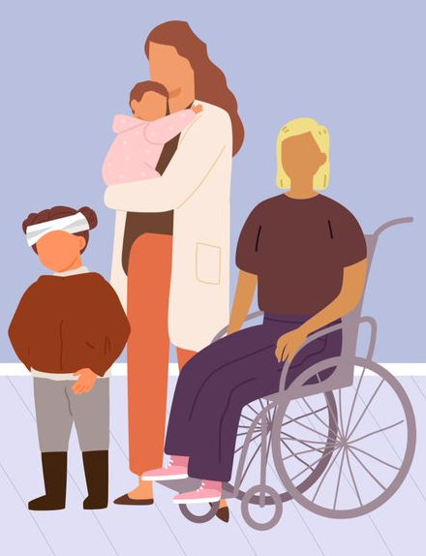
SLEEP
What is the correlation between concussion severity and disturbed sleep patterns? What tools, aids, medications, or other interventions are most effective in managing these sleep disturbances?

Slide 11
HEALTHCARE TRAINING
How can the training of front-line physicians and other healthcare providers to recognize, diagnose and manage concussion be improved and kept up to date?

Slide 12
THANK YOU
Steering Group
Shannon Bauman
Mark Bayley
Randene Duncan
Phil Fait
Erin Fox
Isabelle Gagnon
Kanika Gupta
Ash Kolstad
Rosemary Macklem
Lyle McKellar
Kinga Olszewska
Michelle Quinlan
Noah Silverberg
Evidence Checkers
Lisa Marie Langevin
Stephanie Cowle
Veronik Sicard
Javeria Atique
Mica Marbil
JLA Advisor
Katherine Cowan
Research Coordinators
Liz Legace
Quinn Correll
Principal Investigator
Martin Osmond
Co-Investigators
Rhonda Correll
Peter Gill
Colin Macarthur
Nick Reed
Roger Zemek

Slide 13
QUESTIONS?

